Slide 1
What is Prayer?!

Slide 2
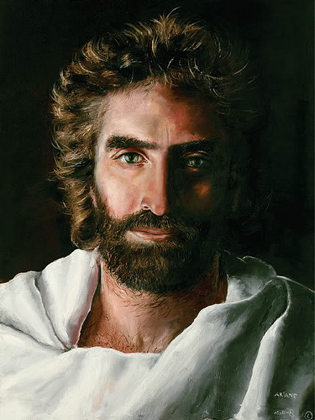
Scripture breaking: Matthew 4:12-23
Notes:
‘The people who sit in darkness’ are the gentiles for their lack of belief in God
The urgency to follow Jesus is what makes his call, the churches call, to us so powerful
This is why prayer must become a regular part of our lives; so that we may hear and better understand our God’s calling to us

Slide 3
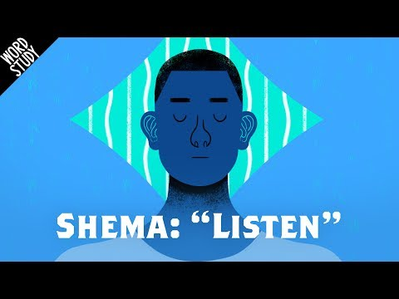

Slide 4
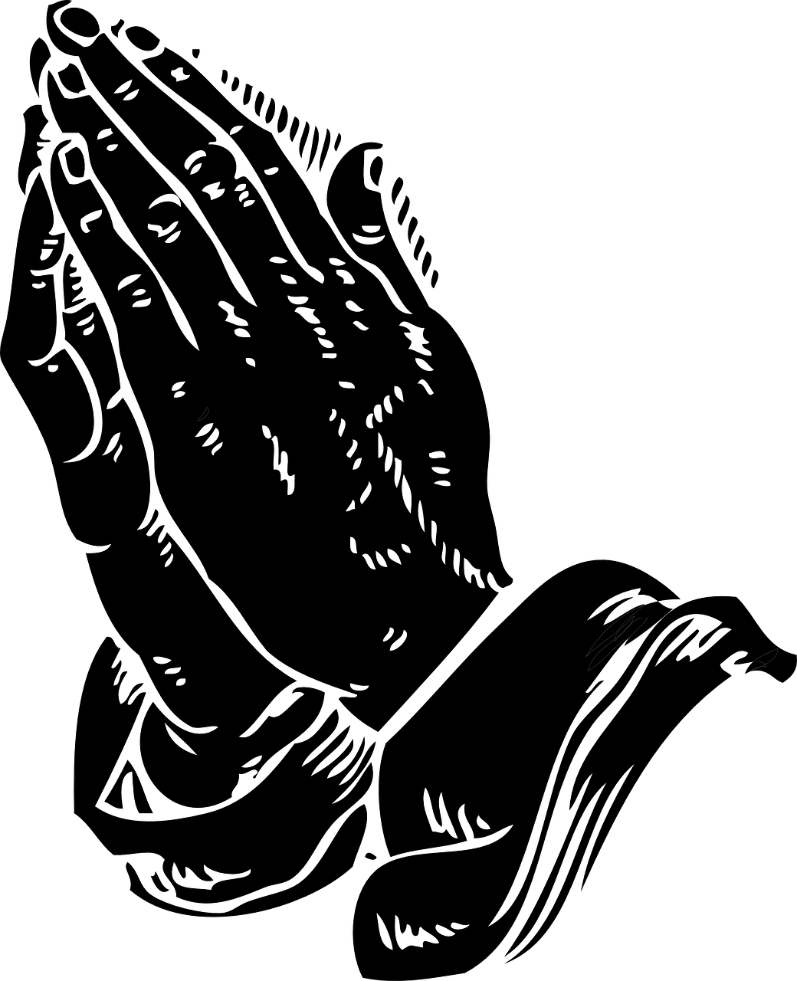
Personal Prayer
Personal prayer is sooooooooo important, for a handful of reasons:
It’s our constant conversation with God
2. It allows us to understand how our God speaks to us
3. It allows us to better hear and listen (shema) to our God’s calling
4. It helps us build a spiritual sense of things that go on in this life

Slide 5
Communal/Family Prayer
There are two types of families that God calls us to pray with and for:
Your mortal/blood family here on earth
2. The eternal family, the family of God; here on this earth and in heaven
God calls us to pray and worship together!!!! Not apart or alone; God is most pleased when his children come together (commune) to pray, worship and give thanks for his mercy and blessings

